Slide 1
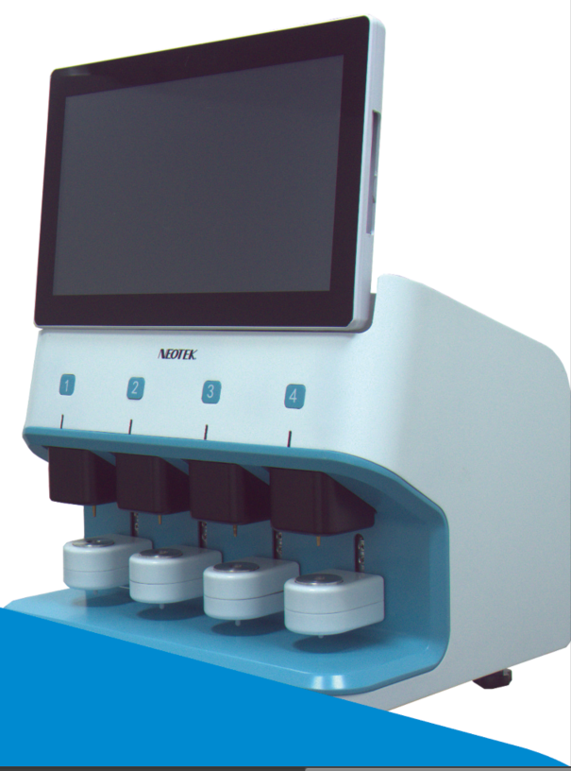
Automation
Thromboelastography

Slide 2
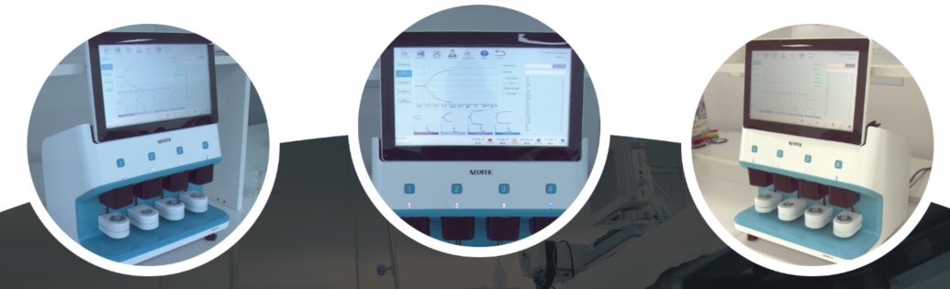
Introduction
Thromboelastography (TEG) is a method of testing the efficiency of blood coagulation.
Signal-4 is more automatic and more stable during the measurement.
New detection principle without patent risk.
Advantaged testing efficiency. Much better user experience.

Slide 3
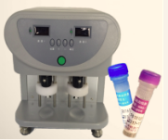
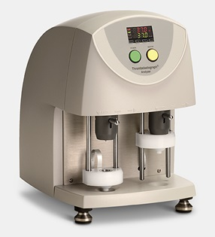
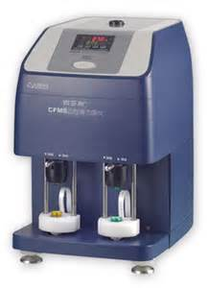
Similar Products
TEG-5000, the earliest machine which can measure all phase of hemostasis in whole blod.
Other products looks like CFMS-LEPU or Yuzeyi, is the copy of THE-5000.
Problem
Too many steps to use this kind of machine;
Only two channels;
Easy damage(should division Load position, Test position, or the torsion wire will be damage )
Not Anti-vibration ;
Need extra computer;
Maintenance difficulties;

Slide 4
What is The Difference
New principle and patents
Automation
4 channels
Embedded display & touch screen
Status display LED & display screen
Support external equipment, USB scanner & Electronic pipettes
HIS and LIS system support
Anti-vibration
Modular design, easy to maintenance
Patient of invention & PCT
Background data collection
Board interfaces, USB2.0 & UART & WiFi & Bluetooth……

Slide 5
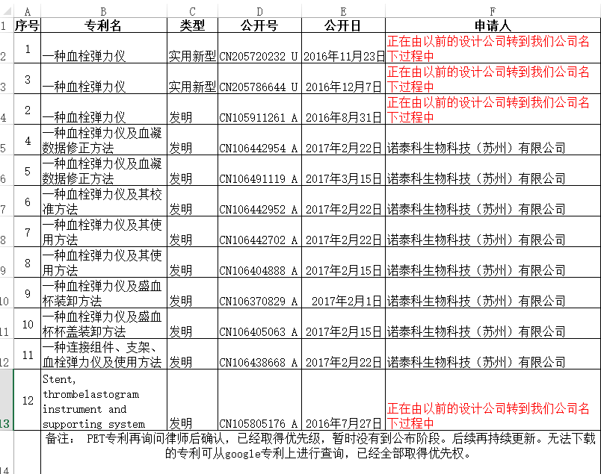
New Patents—patent of invention
New principle and patents, respecting others work and protection our rights
Prevent infringement
Prevent plagiarism

Slide 6
Automation
Reduce operation steps from 17 to 7.
Other Machine | Signal-4
Brackets slide to platform, make sure detect pole in Load position; Take out cup Put cup into clot Slide up the brackets, make sure cup stand up in the clot; Keep machine stable, then install the cover; Check the cover and the detect pole; Slide the bracket down, and compact cup to clot Put in sample Make sure Load pole was in the right position, rise the bracket; Slide bracket up, make it tightly against the bead; Move test pole to test position Pressure F10 to start test；(computer button) Finish the test from computer Make pole to Load position slide the bracket to platform, and make sure cover in the cup; Press the bracket, make the cup out of clot; Drop cup | Take out cup Put cup into clot Pressure button, wait the brackets up, and the cover will be auto install Put in sample Pressure button, detection will be started Automatically finish the test, and remove the cover from machine Drop cup;

Slide 7

4 Channels
Autonomous channels
4 channels, once 4 patients or 1 patient 4 samples
1
Embedded Display screen
2
Easy to use
Touch screen
Support external key board
3
HIS & LIS interface support
HIS & LIS system
Remote configuration enable
4
Automation
Automation load, both cup and cover
Automation finish test

Slide 8
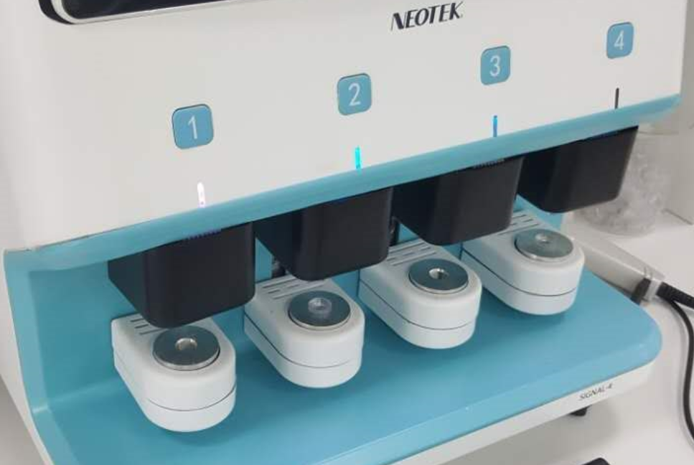
Modular Design
On Signal-4 , all of the function units are modular design;
You can change main function units with out dismember the machine;
Key detection unit, can be used at least 5 years;
Easy damaged unit(may be changed every 3 or 4 years, depend on use frequency ) change do not required calibration;
If need maintenance , this black shade can be removed.
Motor inside, so this unit’s service life depend on motor use frequency

Slide 9
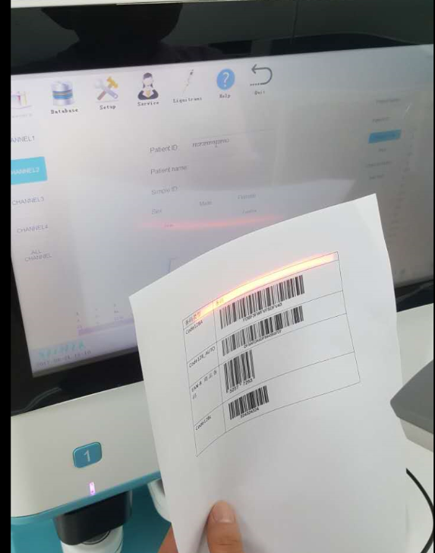
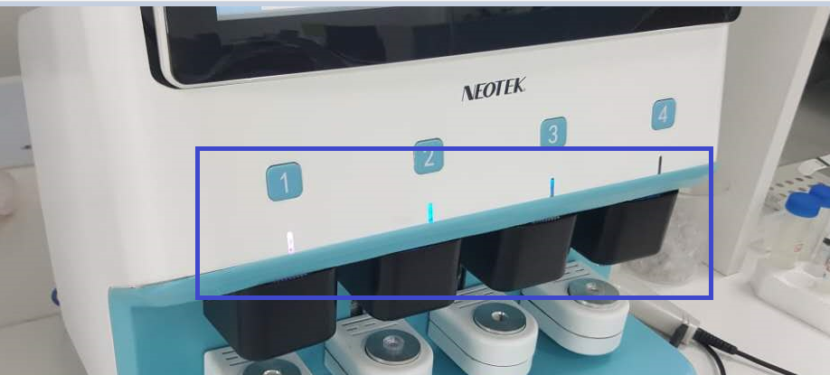
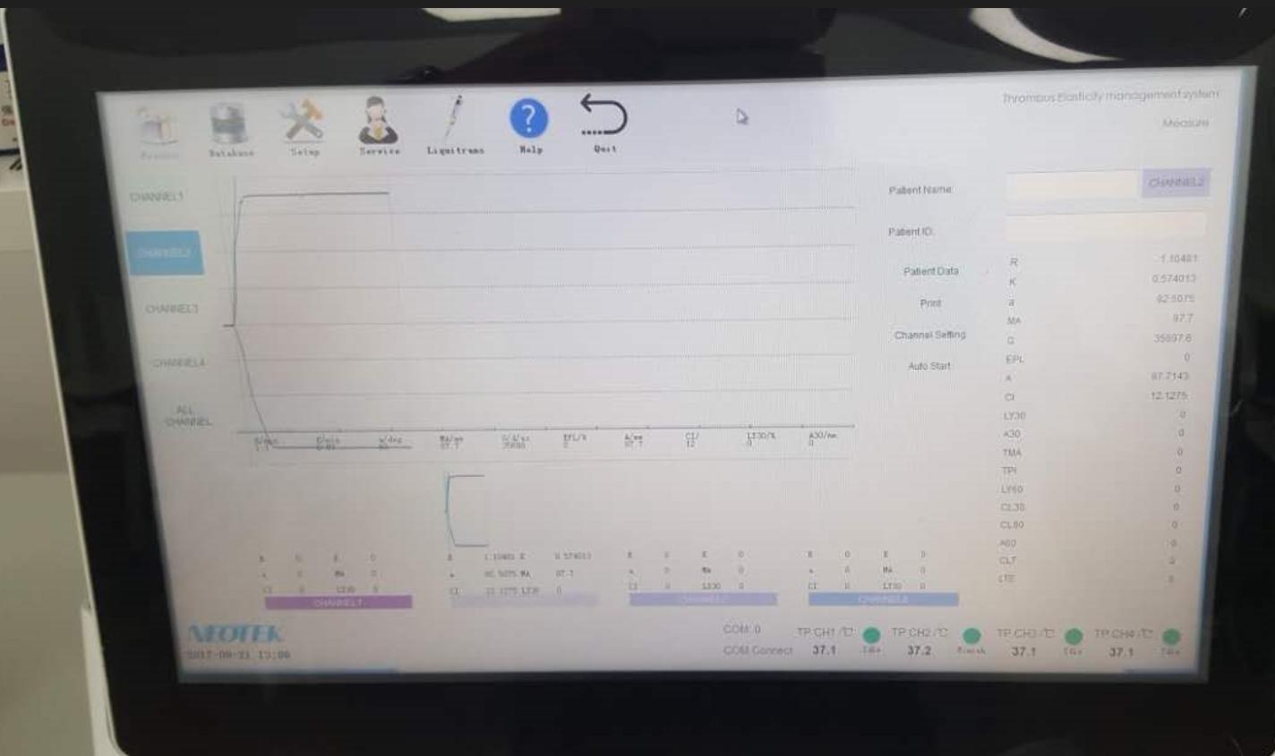
Interfaces
USB 2.0 & Bluetooth &WiFi
Optional GSM card or other background data collection
LED and 15.6-inch touch screen, status indication; Red light, Green light, Blue light, channel free, channel finish test, channel testing……
UI
USB scanner
LED status indication
Scan code, get patient information from HIS
UI system

Slide 10
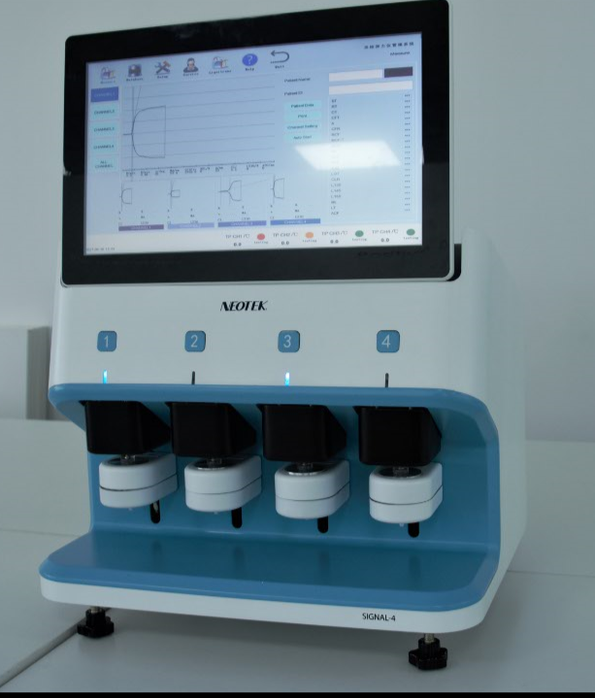
Features
Automation
Just press button;
Just go away, LED will tell you channel status
Operation time reduce 60%
60%
Detection efficiency improve 200%
4 samples one time
Detection time can be chose
200%
Anti-vibration
Anti-vibration
80%
80%
Maintenance cost reduce
50%
Modular design
Key detection unit can be used at least 5 years
Remote configuration enable
50%

Slide 11
Features
Cost advantage
Touch screen inside；
Low overall machine cost；
Single channel cost down 50%
50%
Easy to use
Friendly UI
HIS & LIS system support
USB & RS232
Practicability 200%
200%
New Patents
10 invention patents
2 utility patents
1 design patent
Patent of invention 10件
13
Environmental Requirement
Lower
Wide use range
Temperature range： -10~+30 degree
Voltage range: 110V~260V
75%

Slide 12
Others
Data collection
Have both device and reagent
High Accuracy
Follow Class 3 standard
机器
试剂
检测文件
Same display mode wit TEG-5000
Device from the clinical test

Slide 13
Contact
Addres: Room 402, Building 1, No 8, Jinfeng Road, Suzhou New District, China
Email:sean.xiao@innomddesign.com
Tel:+86-18351112895
Sean Xiao

